Slide 1
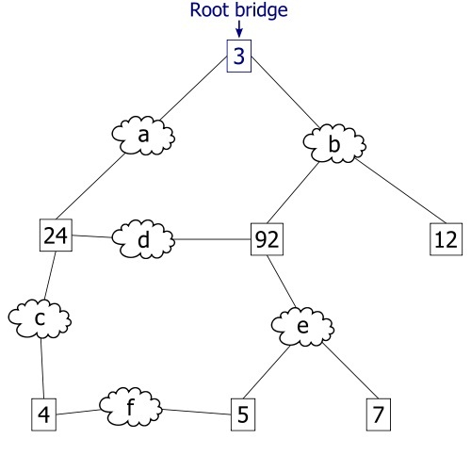
Spanning Tree Protocol

Slide 2
Begins with partially meshed network

Slide 3
Disables ports that make loops

Slide 4
When a break occurs…

Slide 5
It re-enables ports as needed!

